Slide 1
Section 8
Week of April 2

Slide 2
Outline
A few notes
Django: Admin Features
Django: More
Testing
CI/CD

Slide 3
A few notes:
Project 3 due on April 15th
Last project before the final project

Slide 4
Django: Admin Features
https://docs.djangoproject.com/en/2.2/ref/contrib/admin/
Customize your admin page for easier data manipulation
from django.contrib import admin
from .models import [name]
@admin.register([name])
class [name]Admin(admin.ModelAdmin):
fields = ([col-1], [col-2], [col-3])
filter_horizontal = ([many-to-many-field])

Slide 5


Django: Static Files
<link rel=”stylesheet” href=”{% static ‘appName/styles.css’ %}”>
projectName/
manage.py
projectName/
appName/
static/
appName/
styles.css
templates/
urls.py
view.py
models.py
AND OTHERS!

Slide 6
Any Django questions related to project 3?

Slide 7
Testing
Test-driven development: Write specific test cases first and tune the development to those cases
How to Write Good Tests:
Don’t think tests will work for your code? You wrote your code wrong
Correctness
Independent, Repeatable
Testing random numbers? Testing non-determinate functions?
Well-organized
How to maintain a good code base
Figure out what code is doing via tests
Portable, Reusable
Provide Information
Fast

Slide 8
Testing: Unittest
Unittest: a python library with testing capabilities
https://docs.python.org/3/library/unittest.html
import unittest
class Tests(unittest.TestCase):
def testName(self):
“””A descriptive sentence to print with the test“””
# Write your test here
if __name__ == “__main__”:
unittest.main()

Slide 9
Testing: Selenium
https://www.seleniumhq.org/docs/03_webdriver.jsp#introducing-webdriver
Selenium: a library for simulated browser interaction in python
Used combined with unittest to create browser tests

Slide 10
CI/CD
Continuous Integration: continually merge small changes into the main branch, generally after they have passed test cases
Continuous Deployment: deploy small changes frequently
Travis: a tool for automatically running tests once pushed to github
Create a Travis account and link to your github
Travis pulls code when changes occur to run tests
Create a YAML file to configure
https://travis-ci.org/

Slide 11
YAML: A file format for configuration files
key1: value 1
key2: value 2
key 3:
- value 1
- value 2
- value 3

Slide 12
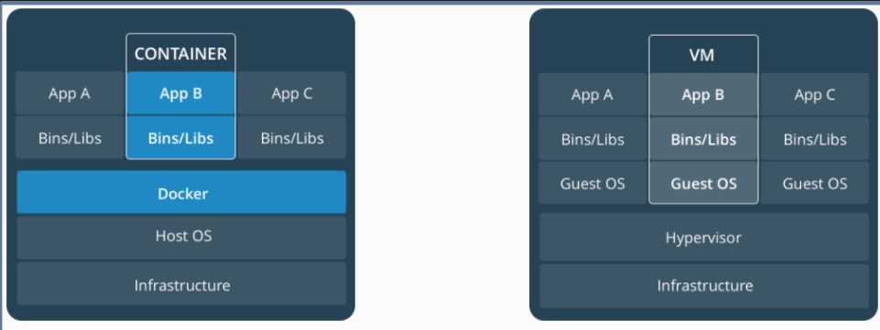
Docker
Docker: a program which creates containers, each of which has all the files and settings necessary to run an app
Containerization: creating these containers, or images
Controlled using a Dockerfile and a YAML file
https://docs.docker.com/engine/docker-overview/
docker compose up (Command to run a dockerfile)

Slide 13
Any remaining questions?

